Slide 1
GifLib: A Community Portal for Sharing your Favorite animated GIFs
Group Members:
Dr. Zahid
Assistant Prof. Anwar
Zahid Anwar

Slide 2



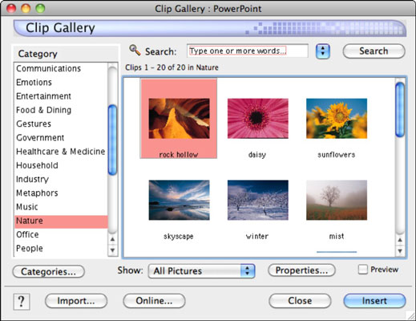
Business model
Customer: Web Developers
Business Model: Web developers constantly require gif images to develop attractive websites but most professional gifs are expensive and have embedded watermarks. The giflib library will be a sharing community where developers and create and share their favorite gifs with other web developers for free.
Benefits: A Giflib library will
Provide ready access to gifs organized by categories
Enable users to rate gifs by marking them as favorites
Allow explore thumbnail view for quick browsing

Slide 3




High-Level Design Flow
Admin
New Category
New Category
****
Category color
Category 1
Login
Add Category
Explore
Upload
New Category
User
****
Delete
Favourite
Login

Slide 4

User Requirements
Upload Gif
Edit Gif
Explore Gifs
Delete Gif
Select Favorite Gif
User
Create New Category
Edit Category
Explore Categories
Delete Category
admin

Slide 5
Delete Category Use Case
Use Case Title: Delete a Category.
Primary Actor: Admin , Level: Actor goal
Precondition: The Category must be viewed in “All Categories” View and must not contain any Gifs
Success Guarantees: Category is deleted. It can no longer be viewed in the list of categories
Main Success Scenario
1. Admin: selects the category list option
2. System: displays all the categories
3. Admin: selects the category to be deleted
4. System: Displays the Category details form
5. Admin: Selects the delete button
6. System: Deletes the selected category and displays the remaining list of categories
Extensions
6a: System: The category is not empty and contains gifs. Admin is prompted that category is not empty and displays an error message.
Delete Category
Flowers
Delete

Slide 6
Design and Architecture
Controller
Service
Persistence
GifController
GifService
GifDao
LoginController
CategoryDao
CategoryController
CategoryService
UserDao
1
Configuration
Model
AppConfig
*
Category
Gif
DataConfig
1
*
SecurityConfig
UserService
User
Role

Slide 7

This Live Demo will constitute the following
Creating a category as an admin
Uploading a gif as a user to the newly created category
Viewing the Gif
Selecting the Gif as favorite
Deleting the Gif

Slide 8
Challenges Faced
Experimented with Intellij environment but it turned out to be slow and complicated. Next time we will use Eclipse.
Lab environment does not allow for
terminal access important for configuring hibernate options
Does not persist project source code and the code has to be download every time
Spring and associated libraries are large and updating gradle takes significant startup time

Slide 9
Known Issues
Gifs should be associated with users that upload them. Therefore
My favorite Gifs feature doesn’t work
A user can delete another user’s gifs
Selecting a category should display list of gifs in that category. This functionality is still broken

Slide 10
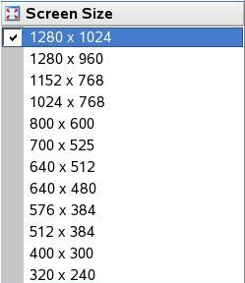
Future Work
Add incentive system to reward contributors
Add search facility
Download as size 1020x720, 800x600 …

Slide 11
Thank you
Questions?

